Slide 1
One hidden layer
Neural Network
Neural Networks
Overview

Slide 2







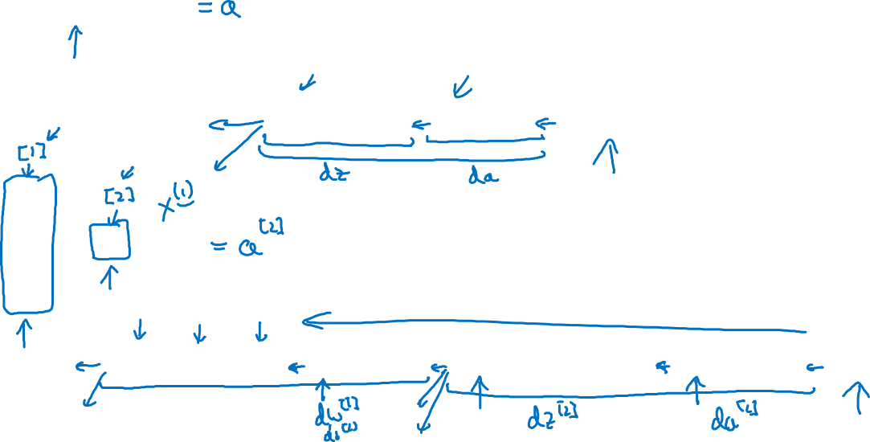
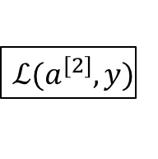












What is a Neural Network?
$$x_{1}$$
$$x_{2}$$
$$\hat{y}$$
$$x_{3}$$
x
w
$$z=w^{T}x+b$$
$$a=σ(z)$$
$$ℒ(a,y)$$
b
$$x_{1}$$
$$x_{2}$$
$$\hat{y}$$
$$x_{3}$$
x
$$W^{[1]}$$
$$z^{[1]}=W^{[1]}x+b^{[1]}$$
$$a^{[1]}=σ(z^{[1]})$$
$$z^{[2]}=W^{[2]}a_{ }^{[1]}+b^{[2]}$$
$$a^{[2]}=σ(z^{[2]})$$
$$ℒ(a^{[2]},y)$$
$$b^{[1]}$$
$$W^{[2]}$$
$$b^{[2]}$$
Notes:
In logistic regression we were computing the z calculation & a calculation in the one & only circle.
In neural networks we have multiple layers & we do this calculation additionally as many times as there are layers.
Notation
Round brackets are used for indexing the training examples.
Square brackets are used for indexing the layers in neural network.
In NN the calculation (z calculation & followed b a calculation is done multiple times)
Similarly we do backward propagation for each step, layer.
This is just taking logistic regression & repeating it twice.

